Slide 1

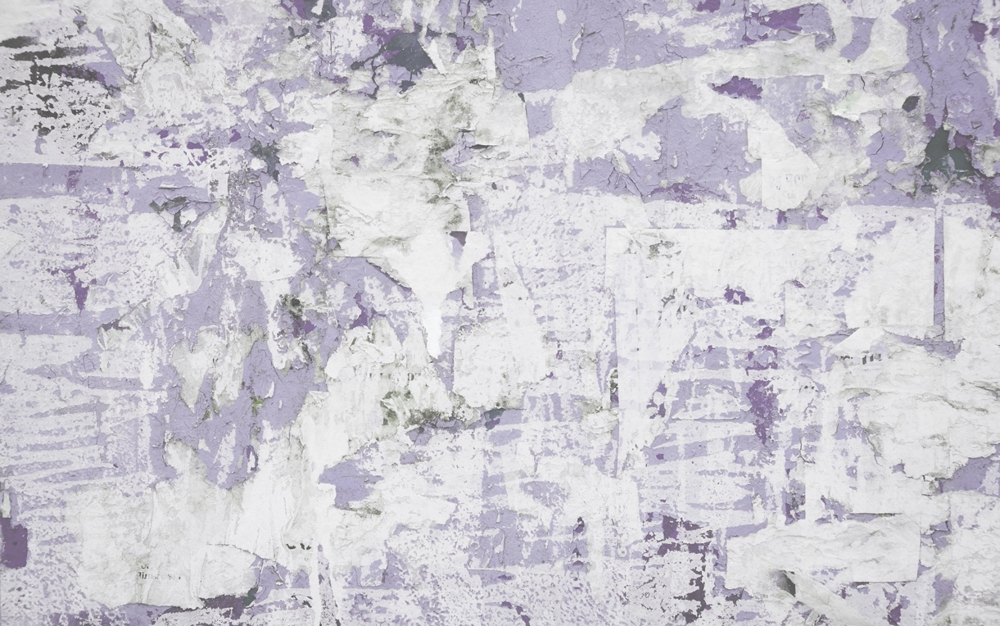



Joint Webinar
Politics of irregularity
www.i-claim.eu
13 March 2024 / 13h00 - 14h00 (CET)
SPEAKERS
Lena Näre, Paula Merikoski
University of Helsinki
Sabrina Marchetti, Letizia Palumbo
Ca’ Foscari University of Venice
Coordinators of the Work package “Politics of irregularity
(WP3) – I-CLAIM project
MODERATED BY
Ilse Van Liempt
Utrecht University
Principal Investigator of the I-CLAIM project.
REGISTER HERE
Views and opinions expressed are however those of the author(s) only and do not necessarily reflect those of the European Union or UK Research and Innovation. Neither the European Union nor the granting authority can be held responsible for them.

